Slide 1
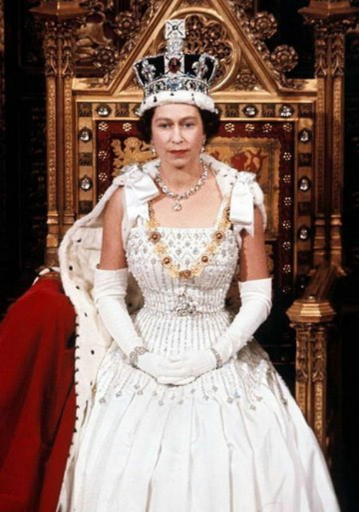
We are remembering Queen Elizabeth and her visit to our school

Slide 2
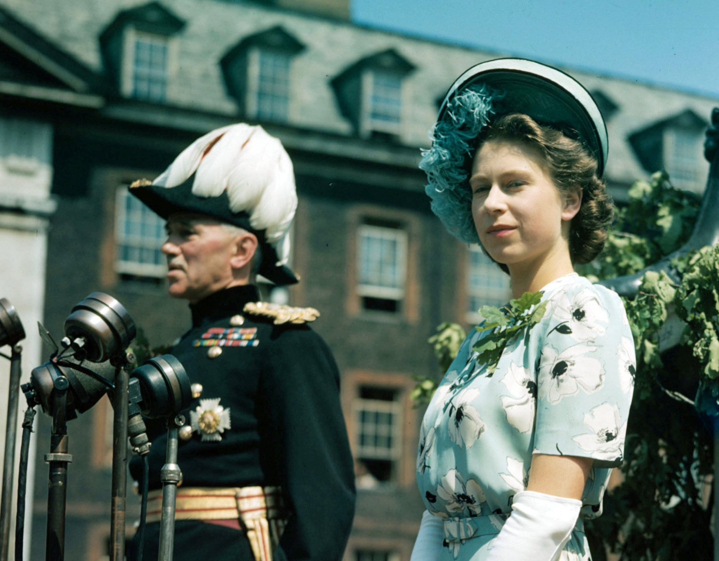

Slide 3
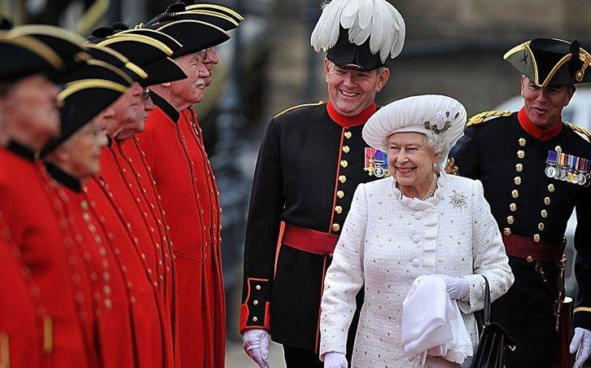

Slide 4
Poplar’s Angel
Join us as we remember the 18 children who died in the bombing of Upper North Street school 100 years ago.
Thursday 15th June 2017
Come to Newby Place at 11:30 AM to see Her Majesty the Queen unveil a plaque outside
All Saints Church, in memory of those who died.
At 12.00 noon you can join the procession from All Saints Church to Poplar Park.
At the park you can see our WW1 displays and exhibits and meet actors in role.
Learn more about Poplar during the war from displays by Mayflower and other local
Poplar schools.
Hear songs by our local Poplar choir, Poplar Singers, brass band music and enjoy refreshments.
At 1:00pm gather at the Angel Memorial. Wreaths will be laid, and short speeches made.
The Last Post will mark 2 minutes silence.
The event will continue through the afternoon until 3:30 PM
This is a community endeavour
and we invite the community of Poplar to join us!

